Slide 1

Phishing email detection

Slide 2

INTRoduction

Slide 3

https://www.itpro.co.uk/phishing/34561/thomas-cook-phishing-sites-skyrocket-following-firms-collapse

Slide 4
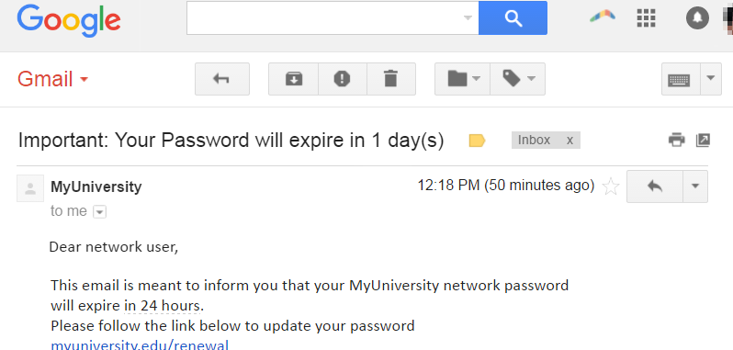
https://www.imperva.com/learn/application-security/phishing-attack-scam/

Slide 5
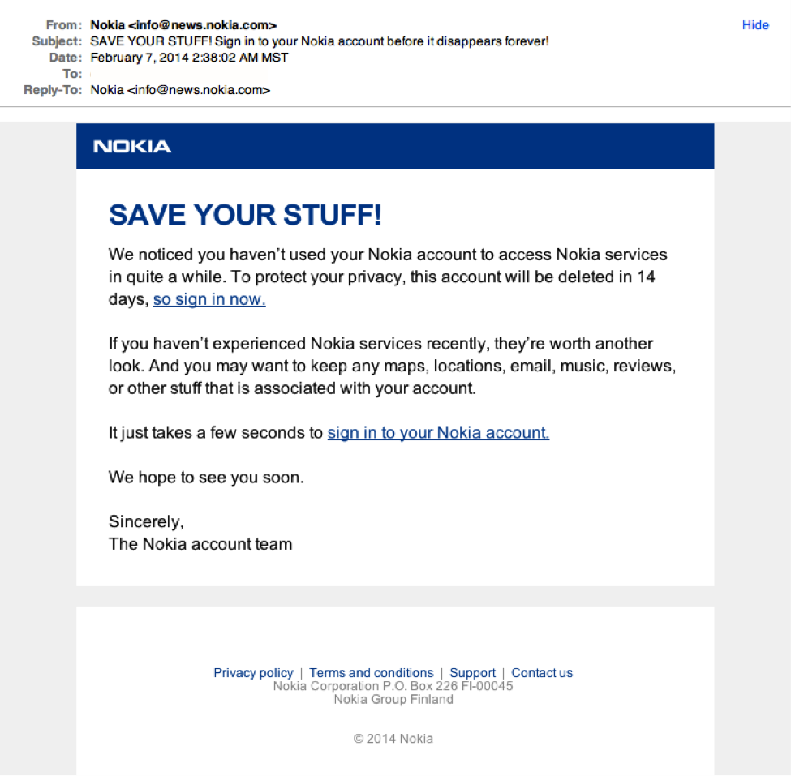
https://www.securitymetrics.com/blog/7-ways-recognize-phishing-email

Slide 6

METHOD

Slide 7
LSTM
WRITE THE important steps

Slide 8

RESULT

Slide 9
CHALLENGES

Slide 10
DEMO

Slide 11
PERFORMANCE ANALYSIS
SHOW GRAPHS

